Slide 1
Employee Data Analysis using Excel
STUDENT NAME : AABITHA BEGAM.A
REGISTER NO : 312206297
DEPARTMENT : B.COM (ACCOUNTING & FINANCE)
COLLEGE : S.S.K.V COLLEGE OF ARTS & SCIENCE FOR WOMEN

Slide 2
PROJECT TITLE
Employee Performance Analysis using Excel

Slide 3
AGENDA
Problem Statement
Project Overview
End Users
Our Solution and Proposition
Dataset Description
Modelling Approach
Results and Discussion
Conclusion
3/21/2024 Annual Review

Slide 4
PROBLEM STATEMENT
Identifying areas of improvement
Providing feedback
Planning for career development
Increasing productivity
Improving communication

Slide 5
PROJECT OVERVIEW
Employee performance analysis involves evaluating various metrics such as productivity, efficiency, and output quality to assess individual and team performance.
By leveraging data analytics, organizations can identify top performers, areas for improvement, and potential training needs.

Slide 6
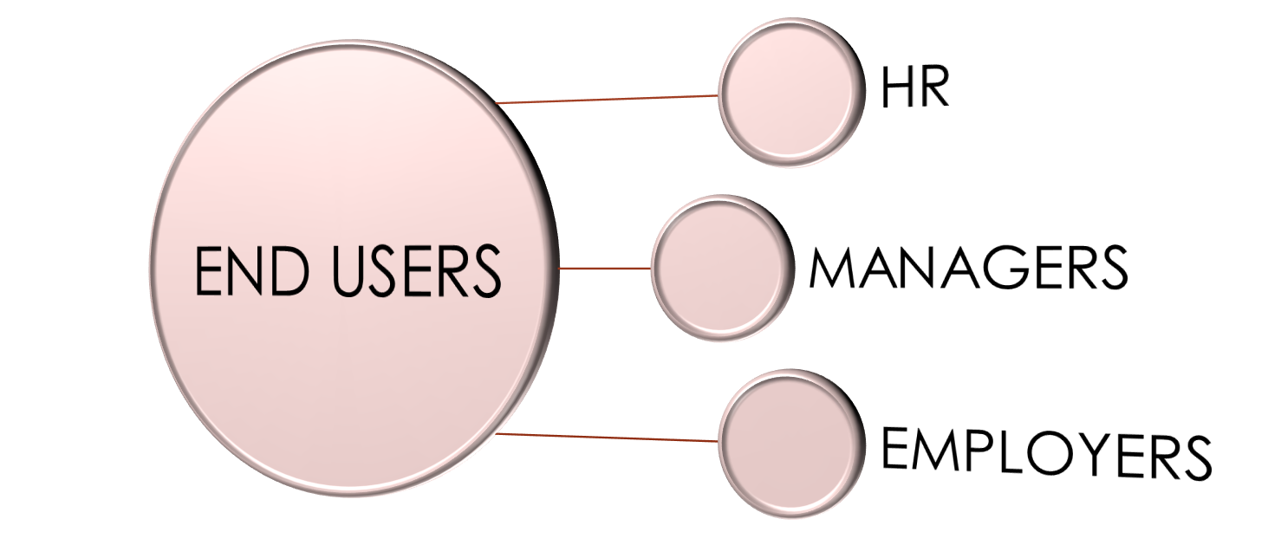
WHO ARE THE END USERS

Slide 7
OUR SOLUTION AND ITS VALUE PROPOSITION
CONDITIONAL FORMATTING
To highlight the missing values
FILTER
To remove the missing values
FORMULAE
To calculate the employee performance level
PIVOT TABLE
To give a summary of the employee performance
GRAPH
For visualize the data of the employee performance

Slide 8
Dataset Description
This dataset includes important attributes of the various business units, process and the productivity of the employees which had been collected manually and also been validated by the organization experts.
It has the following contents on the excel sheet to analyse the performance of the employees
Employee ID
First name
Last name
Employee type
Pay zone
Gender
Employee status
Employee classification type
Current employee rating
Employee performance level

Slide 9
THE "WOW" IN OUR SOLUTION
In this project I used the formulae to analyse the performance level of the employees by using current employee rating
=IFS(Z2>=5,"VERY HIGH",Z2>=4,"HIGH",Z2>=3,"MEDIUM",TRUE,"LOW")
9

Slide 10
MODELLING
COLLECTION OF DATA
The data is collected from the Edunet dashboard to analyse the performance of the employees in the organization.
CONDITIONAL FORMATTING
Conditional formatting is used to identify how much null values or empty values in the data set.
Here are some steps for using conditional formatting in Excel
Select the random of cells, table, or sheets you want to format
click the home tab
click conditional formatting
select manage rules
click the new rule icon, which looks like a plus sign (+)
select the rule type and customize the condition if needed
select the formatting style
click done

Slide 11
MODELLING
FILTER
Filtering option in excel used to remove the missing values in the data set to analyse the performance level of employees better.
Here are some steps for using filter option in excel
select the cells that you want to remove the missing values
on the home tab, select the sort and filter option on the right corner
Then select the option filter by colour and then click on no fill option in the selected cell
to filter out the missing values in the data set.
PIVOT TABLE
Pivot table are useful tool for analysing employee performance data because they can help with summarizing large data set and managing employee data.
Here are some steps for using pivot table in excel
Select a table or range of data in the sheet
Select Insert > Pivot table
Drag the item into the values section twice
Set the summarize values by and show values as options for each one.

Slide 12
MODELLING
GRAPH
Using graph in excel makes the data more presentable and easy to understand. By looking at the chart itself one can draw certain inferences or analysis.
It helps in summarizing a very large data in a very crisp and easy manner.
Here are some steps for using graph in excel
Select the pivot table that you want to insert graph
Then click on insert tab and choose a graph type that you want to insert
The graph will arrive on the desired excel sheet to analyse the performance of the employees in the organization.

Slide 13
RESULTS
13

Slide 14
CONCLUSION
Employee performance analysis using excel has been implemented to cater the needs of company employees and administrative people of the company in submitting appraisals, evaluating the appraisals, calculating the average ratings of the employees and finally generating the consolidated ranks effectively with role based access.
The resultant data will be used by our model to analyse and predict the performance levels of new individuals thus making the recruitment process simpler.
An excel based employee performance rating card and dashboard is very useful and adaptable tool.
It can significantly enhance your performance management process.

Slide 15
THANK YOU

